Slide 1

Information Night 2018
SPFC Team Manager

Slide 2
Club Information
Committee – for full details refer website
President – Vicki Durston Secretary – Penny Hannan
VP Operations – Shane Cross VP Football – Brett Howe
Policies and Procedures – refer website
Smoking
Good Sports – Level 3 Accreditation
Gold Accreditation – Swisse Quality Club

Slide 3
Football Department
VP Football – Brett Howe
Director of Coaching – Steve Kennedy
Co-ordinators
  U8 – U9 – to be confirmed (Brett Howe in interim)
  U10 – U11 – Chris Watts
  U12 – U13 – Scott Rojko
  U14 – U17 – Steve James
  Girls Football – Damian Gleeson
  U10 – U12 – Matt Baxter
  U14-U16 – Terry Ford

Slide 4
Communications
SPFC uses Facebook, Instagram, Twitter and YouTube
To engage members and showcase the great experience the kids have at SPFC
Review Social Media policy – policies and procedures (website)
Ensure that parents are OK with kids images being posted
We will prepare and email for you to send to your team
We will provide weekly newsletter template for you to send to your team

Slide 5
Child Safety
Child Safety Presentation
CSO_Coaches, Trainers & Volunteers.pptx

Slide 6
WWC Checks – Child Safety Policy
Teacher Registration and Vic Police are not accepted
Need to nominate SMJFL on your application or within your account
If have a WWC need to create an account – add SMJFL
SMJFL to assist with this process
Qualifications – including coaching/trainer need to be uploaded into Everproof BEFORE ROUND 1 – or points may be deducted

Slide 7
WWC Check
As a minimum – SMJFL requires the following roles to have WWCC:
Coach Trainer
Assistant Coach Team Manager
Runner Volunteer Umpire
Umpire Escort
HOWEVER - Any person assisting who does not have children at club needs a WWC. So if rotating roles – ensure each parent has WWC

Slide 8
Votes
All teams excluding U8 boys and U10 girls
4 sets of votes each week
Coach, Assistant Coach, Runner and one other parent (MAKE SURE THEY UNDERSTAND THE GAME)
Store in sealed envelopes – each round
  SMALL envelope for each vote slip
  BIG envelope for the 4 votes for each Round
Retain until vote count – SPECIFY DAYS
Club provides a vote counting spreadsheet

Slide 9
Vote Count Night
We will hold two vote count nights. Coaches and Team Managers must attend.
U9 and U10 mixed – Tuesday 7th August, 7pm
All remaining teams – Tuesday 14th August, 7pm
Measure to improve governance and integrity of the vote count. Enable the details to be provided to the club. Enable football department to view results to assist with planning.

Slide 10
Injury
Injury Form
If an injury occurs must complete Injury Form – especially if strapping applied, player cannot go back on, training kit supplies are used or ice is applied.
Photo/scan and send copy to Secretary
Follow up with parents by team – Coach or Team Manager
Club will also follow up on Monday

Slide 11
Infringements
Yellow and Red Cards
Yellow card – off for a quarter – can’t be replaced
Red card – off for the game – can’t be replaced
No form for cards – umpire makes note on CMR
Reports
Separate report form – needs to be signed by both Team Managers
  White Copy – Team Manager of reported player
  Green Copy – Opposition Team Manager
  Blue Copy - Umpire
Advise your Co-ordinator and Secretary (Penny Hannan) ASAP after match. Provide copy of report

Slide 12
SMJFL Umpires – changes
Coloured Wrist bands – based on experience
Two umpires for each game
Trying to pair a novice with experienced

Slide 13
By Law Changes
Trainers – ”Medical Practioner” defined
Modified Rules players – can wear undergarment (skins) under their jumper
U16 and U18 Girls - Footballs
Now using a leather football
Forfeit
Results of 60 – 0 will be entered
Practice Match Incidents
Reports will now occur as per a normal fixture game (SMJFL umpire present)

Slide 14
By-Law Changes
Game Duration and Break Times changed
Trying to enable more games to be fixture
Age group | ¼ duration | ¼ time | ½ time | ¾ time
U8 & U10 girls | 10 minutes | 3 | 6 | 3
U9, U10 & U12 girls | 12 minutes | 3 | 6 | 3
U11-U14 & U14 girls | 15 minutes | 3 | 8 | 5
U16 girls | 15 minutes | 3 | 8 | 5
U18 girls | 17 minutes | 3 | 8 | 5
U15-U17 boys | 20 minutes | 3 | 10 | 5

Slide 15
By-Law Changes
Boundary Umpires cannot lay report
Submit details of incident to Club Secretary after game
U18 Girls, U16 and U17 boys – don’t wait for goal umpire
For these three age groups, defending team doesn’t have to wait for the goal umpire to wave flags to start playing after a point
Red Card – changes to rules
Player cannot be replaced AT ALL (previously after a quarter)
Player cannot play in any other games that Round.

Slide 16
Things to Note
U11 and U12 division names will be colours – not numbers
Possibility for earlier game times (maybe starting at 8am)
Meet the Umpire sessions – 30th April and 18th June
U11 and up – enter goal kickers and bests. Make sure the information is correct, or we get fined for updates

Slide 17
Canteen & Anchor
Canteen will be staffed by juniors – no requirement for parent volunteers
Still need assistance at Anchor – two teams to be allocated/anchor
Anchors for season 2018
Round 1 – 15th April – First Anchor
Round 4 – 6th May
Round 8 – 3rd June
Round 12 – 29th July – Backward Draw
Round 14 – 5th August – U8/U9 Lightning Carnivals
Round 15 – 12th August – U10 LC, Final Round
Finals – dependent on fixture (possibly 3)

Slide 18
Practice Matches
Sunday 25th March - Bentleigh JFC
NEED TRAINER & ACCREDITED COACH
SMJFL UMPIRE – will be treated like real match – can lay reports
Treat like real match – CMR, bibs for volunteers
King George Reserve: Mixed - U8, U9, U10, U11, U12, U13
Centenary Park: Girls - U10, U12, U14, U16, U18,
Boys -U14, U16

Slide 19
Practice Match Times
CENTENARY PARK KING GEORGE RESERVE
Under 10 Girls – 9am (2) Under 8 mixed – 8.45
Under 12 Girls – 10am (2) Under 9 mixed – 9.45
Under 14 Girls – 9am (1) Under 10 mixed – 9.45
Under 16 Girls – 10.15am (1) Under 11 mixed – 11.00
Under 18 Girls – 11.30am (1) Under 12 mixed – 12.15
U14 boys – 12.45pm (1) Under 13 mixed – 12.15
U16 boys – 2.00pm (1)

Slide 20
Presentation Afternoon
Held at Julie Cooper Pavilion for Junior Age Groups
Will section off rooms so that teams can have individual presentations
Date to be confirmed – U8,U9, U10
Potential date – 18th August

Slide 21
Upcoming Events
Superclinic – Friday 13th April
Round 1 – Sunday 15th April
Pie Nights – Week starting 30th April – after training
Social Media Awareness training – Monday 7th May
Trivia Night – Friday 23rd May

Slide 22
Disciplinary Issues
Under no circumstances are Team or Match officials to abuse, threaten or intimidate umpires or opposition players, officials or spectators
ONLY umpire escort and Team Manager can approach umpires
Team Managers may only approach umpire during match for matters NOT relating to manner in which game is officiated
Umpires can report players and team officials
Director of Umpiring and Football Operations Staff can report

Slide 23
Scenario 1 – Injury Stopped Play
Injury on ground. No play for period equal to one quarter
Is there an alternate ground available?
Yes - if both team managers agree – move and continue from time when game stopped (timekeepers need to note time when game stopped)
No – game stopped before half time – game is abandoned
- game stopped 3rd or 4th quarter, team leading shall be
winner and score as at when play stopped entered as final
score

Slide 24
Scenario 2 – Incident, no report
Try to resolve minor issues on game day
Talk to other Team Manager, Talk to Umpire
If no resolution – Contact Age Group Co-ordinator
If lodging a formal complaint – standard form
State facts and use plain English – not emotive
Detailed description – who, when, where, what
3 witness statements
Any injuries – clear description (injury form)

Slide 25
Scenario 3 – Loaning players
Minimum players 12 and Maximum 18
Your team has 14 and the other has 21
What do you do?
Other team must loan players – to even up numbers
Unless – numerical advantage even with loans
  Team with 21 must loan 3 players. Will then be 18 versus 17
Team with advantage only has one extra
Team refuses to accept loan players
  Team with 21 can play 18 players against your team of 14

Slide 26
Team Administration
St Peters Website – Resources / Team Manager
Sporting Pulse
Paperwork
Post match administration
Team Communication - Newsletters
Ground set up and pack up
Responsible for crowd behaviour on game day

Slide 27
New Team Managers

Slide 28
Team Administration
Cordial, Lollies, Oranges – delegate to another parent
Game Day Vouchers – home games (collect from canteen)
Team Kits
Rostering – Set up/Pack Up - Anchor Duty
Point of contact – Events
Follow up - accreditation

Slide 29
Match Paperwork
Team Sheet – Sporting Pulse
Confirm available players
Enter officials for the match
Print team sheet – says 3 copies – but 2 is sufficient
CMR – enter match details
SPFC Match report
Goal umpire and timekeeper cards for your team
Injury Reports – PLEASE SUBMIT
Best and Fairest votes (excl U8 and U10 Girls)

Slide 30
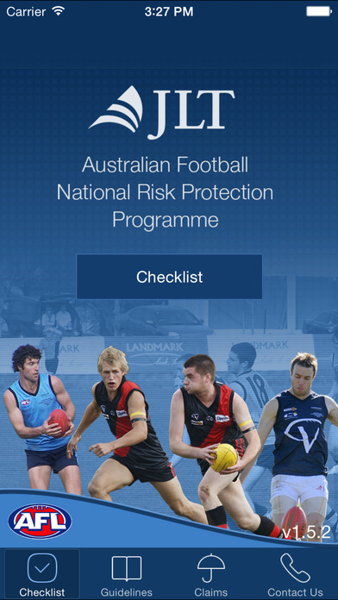
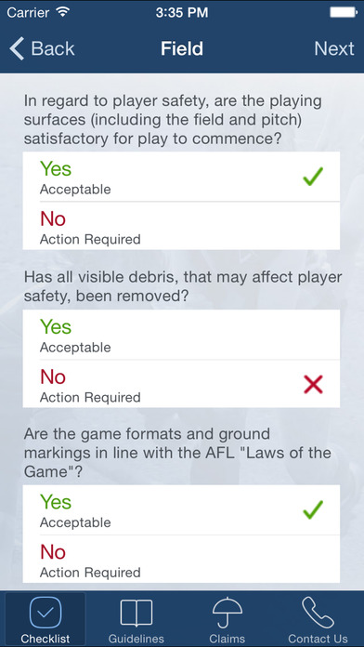

Pre game set up
Venue Set up
  pads on gal posts
  Pick up rubbish off oval
  Modified rules – zone markers
Ground inspection report (AFL Match Day app)

Slide 31
Competition Match Report
Home Team Manager to provide to umpire
At conclusion of match both team managers to sign
  Home Team – Green Copy
  Away Team – Pink Copy
  Umpire – White copy
Mod. Rules – home team umpire to submit details online

Slide 32
Timekeeper and Goal Umpire Cards
Timekeeper score will be used if Goal Umpire cards do not agree
Please note – times on back of card may not apply to your age group. Refer to handbook for your age group’s quarter and break timing – THEY HAVE CHANGED THIS YEAR
Collect at end of game and store with other match paperwork

Slide 33
Team Bench
Team Manager not allowed in bench area.
Only officials permitted in bench area are:
  Coach
  Assistant Coach
  Trainer
  Runner
  Make sure there are no other parents or children in the bench area.

Slide 34
SportsTG
We will include links in a welcome email for:
Training webinar – Pregame, post game
Userguide
Support
Links will also be put in the Team Manager resources page on the website

Slide 35
Results Entry
Modified Rules – U8, U9 and U10 – only enter scores. These will not be displayed online
U11 – U12 – enter scores. Goal kickers and bests (optional)
U13 and above – enter scores, goal kickers and best players
MAKE SURE YOU CHECK THE DETAILS ARE CORRECT. We get fined if we ask for changes
Results to be entered by 8pm match day
Dispute Team Sheet – 12pm Tuesday following match

Slide 36

Concussion
Complete the questions on
Concussion App – Head Check
Download it onto your phone
Simple “YES” or “NO” questions
CONCUSSION POLICY – if concussed
a player needs doctor’s clearance to play
the week after

Slide 37
Team Roles
Coach and Assistant Coach
Coach – all age groups – needs Foundation accreditation
Assistant Coach – for U11+ Foundation accreditation
Coach is responsible for bench behaviour
Cannot enter field of play during the game

Slide 38
Team Roles
Trainer
Requires First Aid Level 1 (all teams)
For U13 and above (requires Emergency Response)
Club provides training – run over two nights – no charge
Dates are: Monday 26th and Wednesday 28th March
At South Oakleigh Club

Slide 39
Team Roles
Umpires
Modified Rules
Must be accredited:
  AFL Vic Club Umpire ONLINE course
  Signed copy of the 2018 Club Umpire Code of Conduct sent to SMJFL
  INFORMATION SESSIONS – UPDATE DATES
U11 and above – League appointed
Remember – they may be learning too! IMPORTANT TO MANAGE SPECTATOR BEHAVIOUR

Slide 40
Team Roles
Other Roles – refer handbook
Timekeeper
Goal Umpire
Boundary Umpire – not in modified rules – U11 to U13
Runner – WWC check
Umpire Escort – WWC Check
Water Carrier – not in modified rules – WWC Check

Slide 41
Team Kit
Jumpers
Match balls (2)
Bibs, goal umpire coat and flags
First Aid Kit
Helmets
Warm up jackets – U14 to U17 only
Water bottles – supplied to coach

Slide 42
Team Communication
Provide team with game day reminders
  Game time – arrival time
  Short colour
  Advise who is rostered on to help
Match reports – if coach wants to write
Keep team updated on:
  club news (e.g. events, SMJFL correspondence)
  team specific news (photo day time, anchor duty

Slide 43
Trophies
Following completion of season – nominate those receiving trophies
Details on trophies in handbook
No extra trophies to be supplied

Slide 44
SMJFL Media Day – Julie Cooper Pavilion
Tuesday 4 April - Red Onion Creative - are capturing content (photos and videos) to be used during the year, for specific campaigns, recognition rounds, events and functions.
require at least 4-6 players from each club (1 boy and 1 girl, from U8-10, U11-13 & U14-18).
looking for enthusiastic, talkative kids from a diverse range of cultural backgrounds. There will be multiple 'stations' for video and photography scenes. Attendees will be given certain scheduled times to ensure people aren't required for a full day, and to reduce wait times.

Slide 45
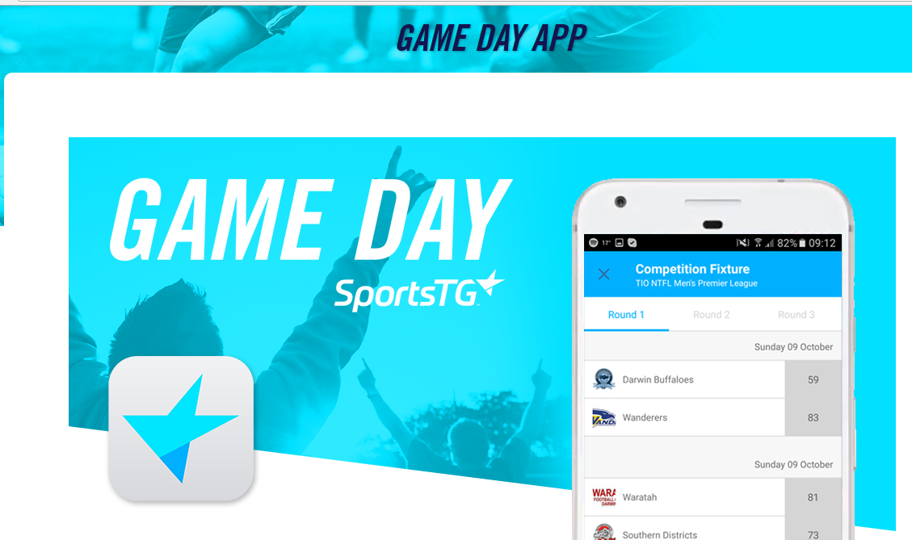
Helpful Apps
Team App - Fixtures, Results, Ladders, News, Events, Notifications & Reminders
Sports TG – Game Day – Fixtures, Results, Ladders

Slide 46
THANKS
GOOD LUCK!!
Teams can’t take the field without you!
Problems - Contact Penny or your coordinator

